Slide 1
Going Cloud Native

Slide 2
Agenda
Monolithic Motivation
Domain Driven Design
Strategic Design
Tactical Design
Cloud Native Design
12 factors
Cloud Native Application
Spring Boot
Concourse
Pivotal Cloud Foundry
Design to Delivery

Slide 3
Monolithic Motivation...consider
Typical Context
You’re developing a non-trivial application that must support a variety of clients such as web, native mobile, mobile web, tablets and wearables. The application has to expose external 3rd-party and internal integration points. The typical request-response flow is to receive a request, validate, perform business logic, access data and/or exchange messages with other systems then return a response to client.
Classic Problem
A rolled up deployment couples together all parts of a software and thus is bulky, hard to change and even harder to deploy with velocity. Force = Mass X Acceleration holds true. Given a relatively stable number of Forces such as teams and technology and an increasing Mass of software we see by natural law Acceleration (delivery) will suffer.
Notes:
Use this to set a context in the audience's mind. Don’t literally read but summarize the typical context and consequences of a monolithic model. Want audience to see a) there is a real problem with development and delivery and b) the larger the “app” the slower delivery becomes.

Slide 4
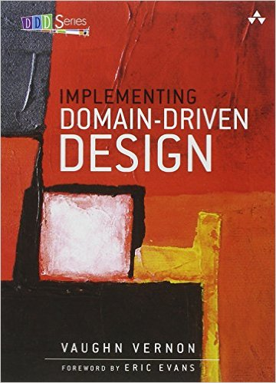
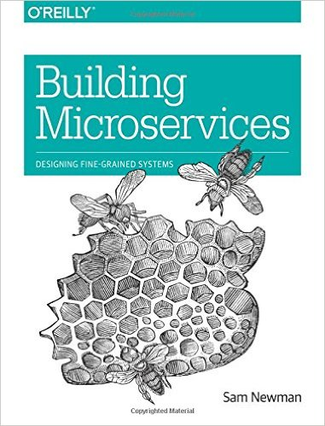
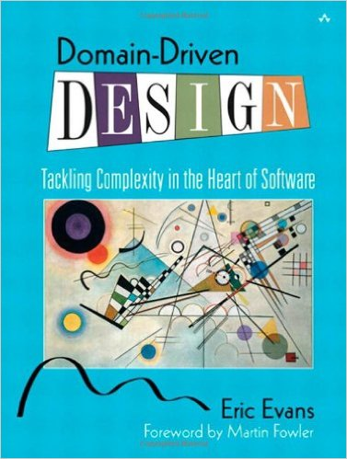
Recommended Reading

Slide 5
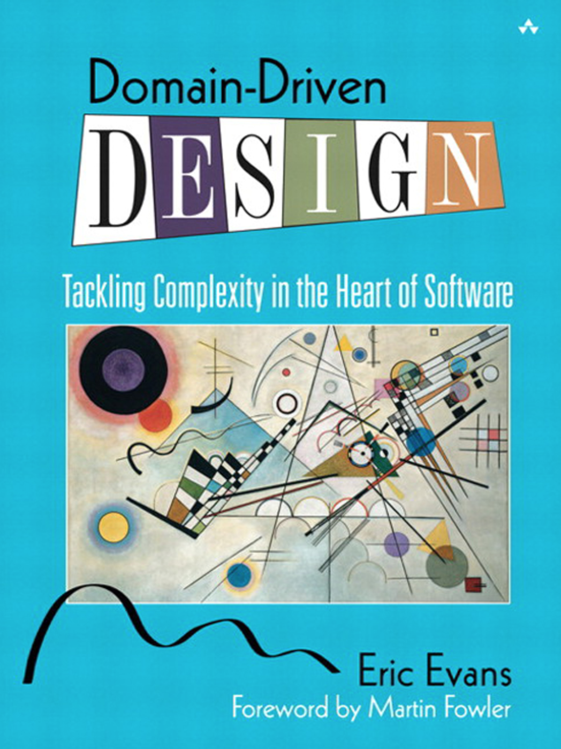
Domain Driven Design
A community based approach for designing software that models the complexity of the real world
Kicked off in 2004 by Eric Evans
Basic principles are
Crunch Knowledge
Communicate with a shared language
Constantly bind reality with model and model with implementation
A practical microservice design methodology
Notes:
Introduce Domain Driven design as a framework to develop a business first approach to software development.

Slide 6
Domain
Driven
Design
Software development as a profit center
Drive a thought first approach culture
Develop a clear mental model
Improve collaboration between businesses
Code quality and testability
Can help ...
Notes:
Domain Driven design can help solve the following problems….

Slide 7
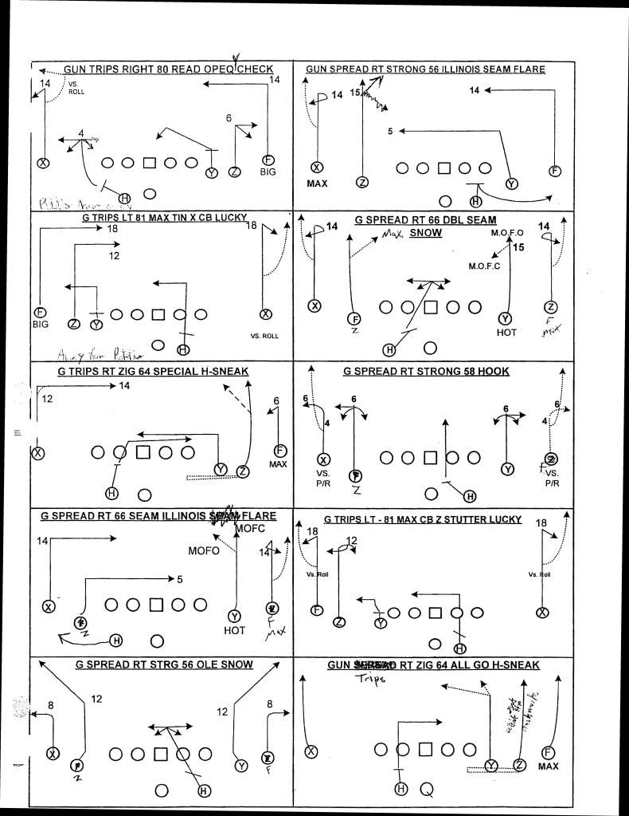
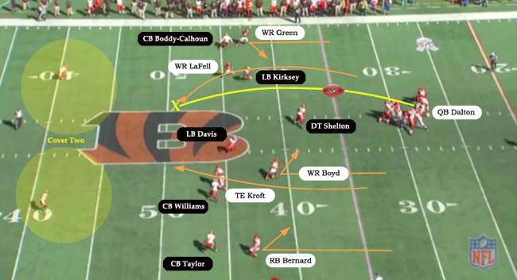
Domain
Driven
Design
Strategic
2 Main parts
Tactical
Notes:
Strategic design highlights what is strategically important to your business, how to divide up the work by importance, and how to best integrate as needed.

Slide 8
Strategic Design
Domain
Subdomain
Bounded Context
Ubiquitous Language
Context Maps

Slide 9
Domains
Domain is always org specific
Captures the unique and fundamental element of the business
Composed of sub-domains & bounded contexts

Slide 10
Domains
Subdomains
Domain is always org specific
Captures the unique and fundamental element of the business
Composed of sub-domains & bounded contexts
Core Domain
Supporting
Domain
Generic
Domain

Slide 11
Domains
Subdomains
Domain is always org specific
Captures the unique and fundamental element of the business
Composed of sub-domains & bounded contexts
Core Domain
Supporting
Domain
Generic
Domain
Build it
Perfectly
Notes:
Core Domain is your business, its what makes you valuable and stand apart from competition. You don’t want just anyone implementing your Core Domain model, you certainly don’t want to couple your Core Domain to a framework (Hibernate Entities), implementing the model requires a programming language of course but strive for low external dependencies for your Core Domain. Simply put, build the Core Domain perfectly.

Slide 12
Domains
Subdomains
Domain is always org specific
Captures the unique and fundamental element of the business
Composed of sub-domains & bounded contexts
Core Domain
Supporting
Domain
Generic
Domain
Build it
Perfectly
Build just enough
Notes:
Supporting Domains, domains that your domain needs to perform a business function. For example in Loan Processing the processor needs to qualify the candidate and thus uses a Credit Bureau to gauge risk. The Processor itself doesn’t design and implement the Credit Bureau but simply needs it to qualify loans. In such cases design business processes just enough such that your function is complete. Consider integrating existing models or tools to supplement your investment in this area. The Subdomain could reuse business concepts and tools from your Core Domain.

Slide 13
Domains
Subdomains
Domain is always org specific
Captures the unique and fundamental element of the business
Composed of sub-domains & bounded contexts
Core Domain
Supporting
Domain
Generic
Domain
Build it
Perfectly
Build just enough
Buy It
Notes:
Generic Domain - This gets down into common business processes that are so common you shouldn’t reinvent the wheel here. For example don’t go implement an SMTP server to send emails, or stitch together a cloud platform to run your apps. Invest dollars in the development of your Core Domain and deployment of tooling that you have no business case for re-developing.

Slide 14

Bounded Context
Strategic Design
Semantic contextual boundary where your model is implemented and a Ubiquitous Language spoken
Separate Bounded Contexts should be separate software artifacts
Each component inside the Bounded Context has a specific meaning and does specific things
Developed to distinguish your organization competitively from all others
Choose wisely what should and shouldn’t be part of your Core Domain
Don’t underestimate the power of the Bounded Context

Slide 15


Strategic Design : Bounded Context + Teams + Repos
One team owns one or more Bounded Contexts
Bounded
Context
A
Schema
A
Repo A

Slide 16


Strategic Design : Bounded Context + Teams + Repos
One team owns one or more Bounded Contexts
Bounded
Context
A
Schema
A
Repo A
Schema
B
Bounded
Context
B
Repo B
Multiple teams shouldn’t work on same Bounded Context

Slide 17
Bounded Context
Banking
Security
Account
Account
Account
Context is important!

Slide 18
Ubiquitous Language
Technical Jargon
Business Jargon
Notes:
Talk about the importance of developing a common language that is spoken among all teams. Internal slang and acronyms are perfect for quick communication among teammates, however be careful with what you expose outside the Bounded Context (more on relationships later). This is where technical jargon and business terminology combine to create a pervasive language within a Bounded Context.

Slide 19
Context Maps
Mappings
A map of the existing organization & integration relationship between different bounded contexts
Web
Analytics
Partnership
Shared kernel
Customer-Supplier
Conformist
Anti-corruption layer
Open host service
Published language
Big ball of mud
Separate Ways
Security
Banking
Expense
Tracking
Offers
Service
Notes:
Context Maps are how businesses define relationships between Bounded Contexts. It’s an important because you’ll surface any critical relationships and the nature in which they are handled.

Slide 20
Context Mapping - Partnership
Security
Banking
Co-operation - 2 Teams succeed or fail together
Notes:
This is a fully acknowledged partnership, both Bounded Contexts are dependent on each other thus openly communicate with each other.

Slide 21
Context Mapping - Shared Kernel
Two teams decide to share part of a model
Banking
Security
artifact
artifact
artifact
Notes:
Perhaps it’s best if 2 teams share part of a model to leverage reuse. In such cases the shared model should result in a separate artifact being delivered.

Slide 22
Context Mapping - Customer-Supplier
Could involve terms, success of Supplier partially depends on success of Customer
Sensitive to Customers needs
Banking
Loan Processing
Accurate and Timely information

Slide 23
Context Mapping - Conformist
Upstream
Banking
Banking Branch
Banking Branch conforms to Banking standards set at corporate level
Downstream
Notes:
Conform whether or not upstream model has everything downstream needs.

Slide 24
Context Mapping - Anti-Corruption Layer
Refuse to conform, translate to internal Bounded Context concepts
Team 1
Upstream
Team 2
ACL
Popular in Legacy to Microservice relationships
Downstream

Slide 25
Context Mapping - Open Host Service
Optional
participation
Team 2
Team 1
OHS
Open your system for integration

Slide 26
Context Mapping - Published Language
Common Language for translating between Bounded Contexts. Think JSON, YAML, XML.
Optional
participation
Team 1
Team 2
PL

Slide 27
Context Mapping - Big Ball of Mud
Lots of intermingled models
Downstream
Team 2
Team 1
ACL
Upstream
Notes:
The Big Ball of Mud is a type of ACL relationship where one Bounded Context represents lots of interdependent models that you must parse and make use of. Typical situation around legacy integration.

Slide 28
Context Mapping - Separate Ways
Team 2
Team 1
Break a dependency and re-implement gaps internally
Notes:
It may make sense to break an existing relationship because it would just be easier to re-implement and maintain along with your Bounded Context. Be careful with this and don’t use as a means to avoid teams or slip into a fully internalized context when you really need the support of a relationship.

Slide 29
Tactical Design
Entities
Value Objects
Aggregates
Services
Factories
Repositories
Modules
Events

Slide 30
Tactical Design
Tactical Design is scoped to a Bounded Context
Module
Value Object
Service
Factory
Entity
Aggregates
Repository

Slide 31
Tactical Design - Entity
Module
Entities are individual “things” in your Model
They will have a unique identity
Entities are not Value Objects
Service
Value Object
Factory
Entity
Aggregates
Repository

Slide 32
Tactical Design - Value Object
Module
Not a “thing” in the Model
Used to describe and/or quantify a “thing”, such as a property like “color” or “amount”
Immutable
Service
Value Object
Factory
Entity
Aggregates
Repository

Slide 33
Tactical Design - Aggregates
Module
Aggregates shouldn’t mutate business models or processes
Favor small & shallow Aggregates
Design for eventually consistent Aggregates
Aggregate Entity and Value Objects
Value Object
Service
Factory
Entity
Aggregates
Repository

Slide 34
Tactical Design - Services
Module
Service operations should perform stateless functions
Functionality to augment functionality not naturally included in Entities
Typically defined as a contractual interface
Value Object
Service
Factory
Entity
Aggregates
Repository

Slide 35
Tactical Design - Factories
Module
Don’t express parts of the Model
A method to express creation, possibly creation of non-trivial Aggregates
Essential support function of a Model
Value Object
Service
Factory
Entity
Aggregates
Repository

Slide 36
Tactical Design - Repositories
Module
Encapsulate the technical details of data access
Decouple model from data
Conceptual container around Entities and Aggregates
Value Object
Service
Factory
Entity
Aggregates
Repository

Slide 37
Tactical Design - Modules
Module
Modules provide further categorization within a Bounded Context
A Bounded Context can contain one or more Modules
Separation of concerns
Value Object
Service
Factory
Entity
Aggregates
Repository

Slide 38
Tactical Design - Events
Module
Represents a change in the domain
Model as a Noun with Past-tense Verb, for example ClaimCreated, ClaimSettled
Events carry state transfer data
Value Object
Service
Factory
Entity
Aggregates
Repository

Slide 39
Cloud Native Design - 12 factors
Codebase
One codebase tracked in revision control, many deploys
Dependencies
Explicitly declare and isolate dependencies
Configuration
Store config in the environment
Backing services
Treat backing services as attached resources
Build, release, run
Strictly separate build and run stages
Processes
Execute the app as one or more stateless processes
Port Binding
Export services via ports
Concurrency
Scale out via the process model
Disposability
Maximize robustness with fast startup and graceful shutdown
Dev/Prod Parity
Keep dev to prod as close as possible
Logs
Treat logs as event streams
Admin Processes
Run admin and management tasks as one-off processes

Slide 40

Cloud Native Design - Codebase
ExpenseIT
v 1.0.0
ExpenseIT
v 1.1.0
Expense
Tracking
Codebase
One codebase tracked in revision control, many deploys
ExpenseIT
v 1.1.1
ExpenseIT
v 2.0.0

Slide 41
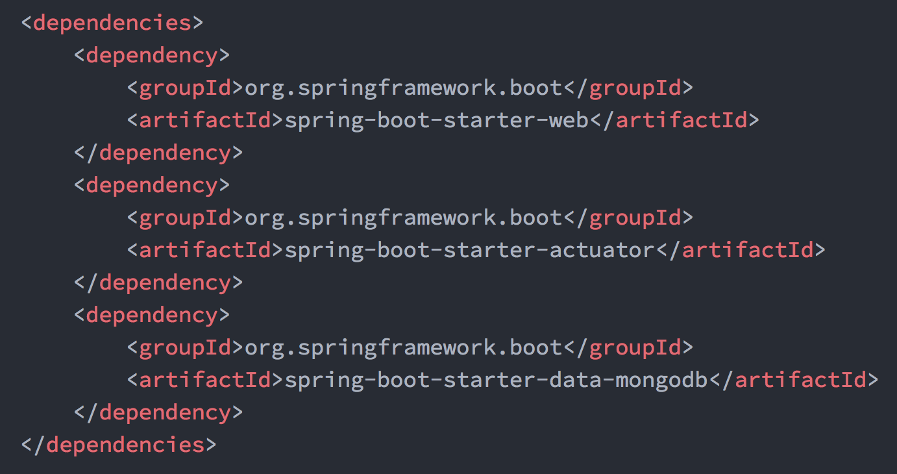
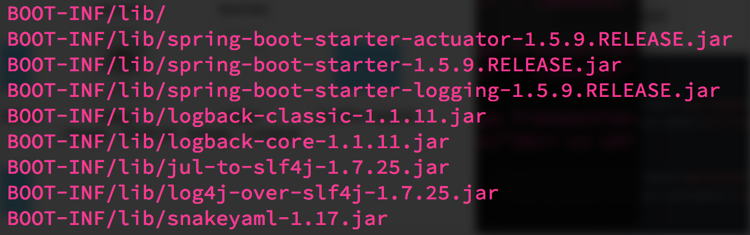
Cloud Native Design - Dependencies
Declaration
Explicitly declare and isolate dependencies
Isolation

Slide 42
Cloud Native Design -
Configuration
ExpenseIT
v 1.1.0
ExpenseIT
v 1.0.0
ExpenseIT
v 2.0.0
Store configuration external to application
Config Server

Slide 43




Cloud Native Design -
Backing Services
ExpenseIT
v 2.0.0
Treat backing services as attached resources
Attached Resources

Slide 44
Cloud Native Design -
Build, Release, Run
Build
Strictly separate build, release and run phases
run
Build
Release
v 1.1.1
Config
{ }

Slide 45
Cloud Native Design -
Processes
Build
Stateless Processes
Execute the app as one or more stateless processes
Stateful Backing Services

Slide 46




Cloud Native Design -
Port binding
7001
8001
9001
Monolith
Monolith
Monolith
Export Services via Port binding
Self contained
Inside out export services
Apps can become backing services for other apps via Port binding

Slide 47

Cloud Native Design -
Concurrency
Scale out via the process model
Build
VMs can only grow so large
Scale apps across multiple processes

Slide 48
Cloud Native Design -
Disposability
prod.cfapps.io
Build
Apps can start or stop at a moment's notice
Maximum robustness with fast startup and graceful shutdown
prod.cfapps.io
prod-tmp.cfapps.io
Strive for fast startup
Build
prod.cfapps.io
And graceful shutdown
Build

Slide 49
Cloud Native Design - Dev/Prod Parity
Time
Personnel
Technology
Developer changes takes day, weeks or months to get into production.
Developers develop code and Ops deploys code in Silos.
Developers use one technology in lower environments and company uses another in prod (i.e windows to linux)
Keep dev, staging and production as similar as possible
 | Traditional App | 12-factor App
Time between deploys | days/weeks | mins/hours
Dev vs. Ops | different folks | same folks
Dev & Prod Environments | Divergent | Similar

Slide 50
Cloud Native Design -
Logs
Treat logs as event stream
Apps shouldn’t manage logs
No routing or storage for logs
Unbuffered event stream to stdout

Slide 51
Cloud Native Design -
Admin Processes
Build
Admin Tasks
DB Migrations
Running a console
Clean-up scripts
Versioned with App
Boot Actuators
Boot DevTools
Run admin/management tasks as one-off processes

Slide 52
Cloud Native Evaluation
Cloud Native
Microservice Architecture
API first design
Design for failure
Apps are unaffected by dependent service failure
Proactive testing for failure
Metrics and monitoring baked in
Cloud agnostic runtime implementation
Cloud Resilient
Cloud Friendly
12 Factor apps
Horizontally scalable
Leverage platform for HA
Cloud Ready
No file system requirements
Containerized
Platform managed addresses and ports
Consume Platform services
Notes:
Forces
There is a team of developers working on the application
New team members must quickly become productive
The application must be easy to understand and modify
You want to practice continuous deployment of the application
You must run multiple copies of the application on multiple machines in order to satisfy scalability and availability requirements
You want to take advantage of emerging technologies (frameworks, programming languages, etc)

Slide 53
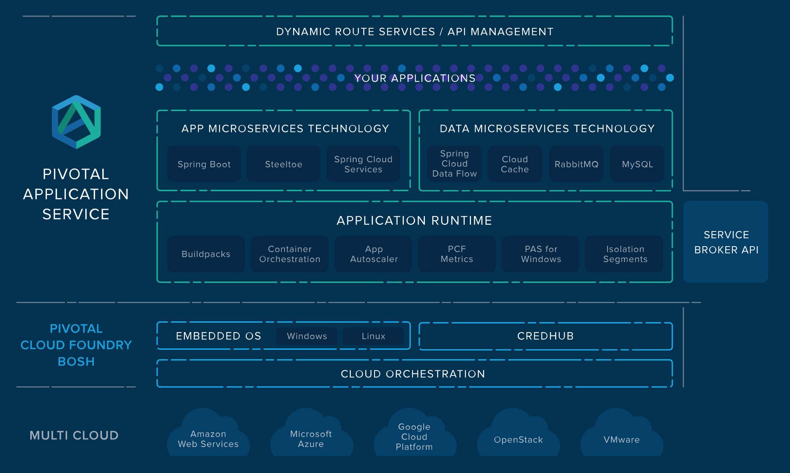
Pivotal Application Service
Notes:
#1 Codebase
One codebase tracked in revision control, many deploys
#2 Dependencies
Explicitly declare and isolate dependencies
#3 Configuration
Store config in the environment
#4 Backing services
Treat backing services as attached resources
#5 Build, release, run
Strictly separate build and run stages
#6 Processes
Execute the app as one or more stateless processes
#7 Port Binding
Export services via ports
#8 Concurrency
Scale out via the process model
#9 Disposability
Maximize robustness with fast startup and graceful shutdown
#10 Dev/Prod Parity
Keep dev to prod as close as possible
#11 Logs
Treat logs as event streams
#12 Admin Processes
Run admin and management tasks as one-off processes

Slide 54

Transforming How The World Builds Software
© Copyright 2017 Pivotal Software, Inc. All rights Reserved.

